Slide 1
Multi-Label Classification by Mining Label and Instance
Correlations from Heterogeneous Information Networks
Date: 2014/05/27
Author: Xiangnan Kong, Bokai Cao,
Philip S. Yu
Source: KDD’13
Advisor: Jia-ling Koh
Speaker: Sheng-Chih Chu

Slide 2
Outline
Introduction
Meta-path-base Correlation
PIPL Algorithm
Experiment
Conclusion

Slide 3
Introduction
The label correlations are not given and can be to learn from moderate-sized data.
Use heterogeneous information networks to facilitate the multi-label classication process.

Slide 4
Single-label Classification
Ex:Single-label Classification
d1 d2 d3
Economy 1 0 0
Art 0 1 0
Polity 0 0 1
Ex: Muti-Label Classification
d1 d2 d3
Economy 1 1 0
Art 0 1 1
Polity 1 0 1

Slide 5
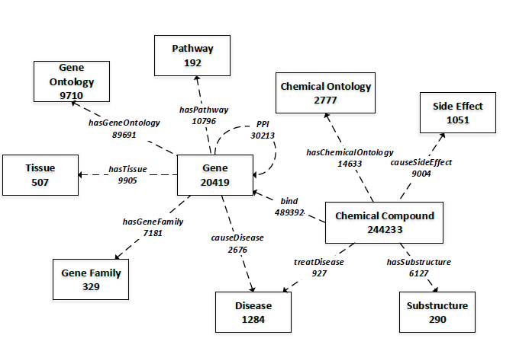
Multi-label Classificantion
EX: Drug-Target Binding Prediction
Instance
label

Slide 6
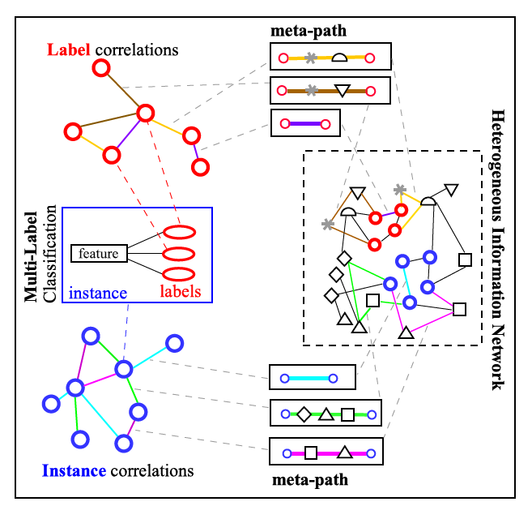
Heterogeneous Information Networks
EX:

Slide 7
Framework
Meta-path Constructure
Meta-path- based Label and Instance Correlation
Iterative Inference
Training Initialization
Model
Output
Bootstrap

Slide 8
Outline
Introduction
Meta-path-base Correlation
PIPL Algorithm
Experiment
Conclusion

Slide 9
Label and Instance correlation
Label :
The same gene correlation
Share similar pathway
Inter-connected through PPI link
Instance:
Similar side effects
Chemical ontologies
Similar substructures (feature)

Slide 10
Meta-path-base Correlation
Meta-path-base Label Correlation
Meta-path-base Instance Correlation

Slide 11
Outline
Introduction
Meta-path-base Correlation
PIPL Algorithm
Experiment
Conclusion

Slide 12
PIPL Algorithm
Meta-path Constructure

Slide 13
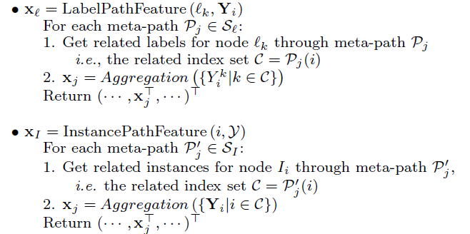
Training Initialization
Yi: each Instance has a label set.
Pj(i):link i-th label through meta-Path j
考慮本身之外xi,跟xi有關係之label,跟xi有關係之Instabces
Array(2-dimention)

Slide 14
Bootstrap & Iterative Inference
μ: unlabeled instances

Slide 15
Outline
Introduction
Meta-path-base Correlation
PIPL Algorithm
Experiment
Conclusion

Slide 16
Experiment
Heterogeneous Information networks:
290K nodes , 720K edge(SLAP)
Gene-Disease Association Prediction:
1943 instances , 300 feature , 50 labels
Drug-Target Binding Prediction:
5651 instances,1500 feature, 50 labels
5-fold cross validation

Slide 17
Evaluation Metrics
Micro-F1 ↑,Better
HammingLoss ↓,Better
SubsetLoss↓,Better

Slide 18
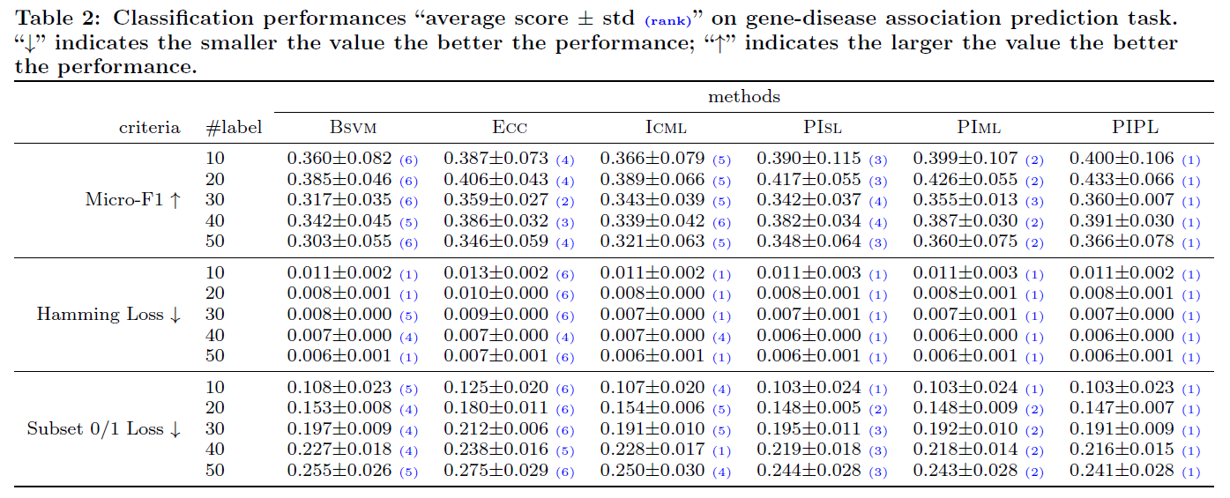

Slide 19
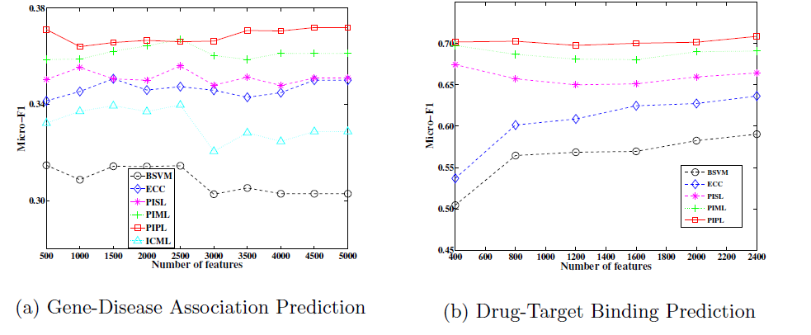

Slide 20
Outline
Introduction
Meta-path-base Correlation
PIPL Algorithm
Experiment
Conclusion

Slide 21
Conclusion
The Paper proposed to use heterogeneous information networks to facilitate the learning process of multi-label classication by mining label correlations and instance correlations from the network.
And propose a novel solution to multi-label classication, called PIPL by exploiting complex linkage information in heterogeneous information networks.

